Slide 1
Traffic Signal Duration Control using Deep Learning
Group No. 1
JohnAnand Abraham 03
Pratik Nerurkar 52
Calden Rodrigues 63
Guide: Prof Sunantha

Slide 2
Problem Statement
In todays scenario, commute is a big part of our life and congestion on the road is increasing due to many factors including too many cars, obstacles (merging of roads), mistimed traffic signals etc.
There exists no system that can suggest changes to the flow of traffic in real time or perform any analysis to de-escalate the congestion at the junction.
Signals from neighbouring junctions are not in sync with each other.

Slide 3
Scope
Detect the number of vehicles and their type(optional) in least amount of time.
Emulate the real time data acquired to get an overview of the current scenario.
Suggest most ideal timings to switch between Green to Red or Vice-Versa to reduce traffic flow in real time.
Make prediction based on previous data of congestion.
Make prediction based on information gained from peer signal nodes.

Slide 4
Comparison of Literature
[1] Use of induction loop traffic detector to determine the frequencies of vehicles (outside India)
Signals are controlled through a pre-set timing system which at times result in pileups during peak hours or induce drivers to skip signals during lean hours, this usually causes a policeman as a replacement for the signal. (in India)
[2] Use of actuators to trigger vehicle counters and change signal timings accordingly.
[3] Comparison of the various background subtraction techniques available
[4] Use of morphology - dilate, findContours, boundingRect, drawing(Rectange, circle, polylines), bit-wise and, createBackgroundSubtractorMOG2.
[5] Use of genetic algorithm to predict signal timings.

Slide 5
Requirements
Hardware
Hikvision 2MP 1080p Night-vision Camera
Software
OpenCV OR DarkFlow & Keras (YOLO2)
Python3 and TensorFlow

Slide 6
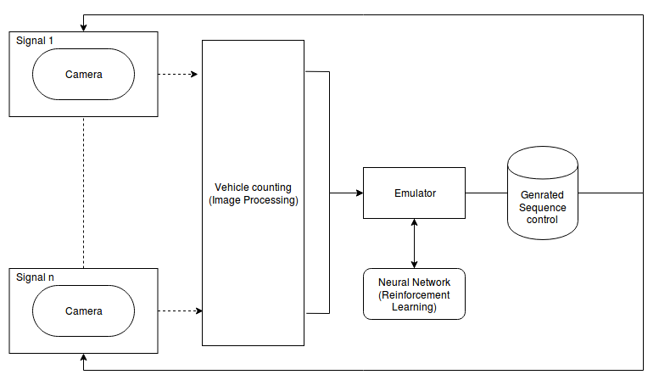
Design Details

Slide 7
Implementation
Input image as img
Generate a exit mask based on the size of the image
Create Background subtractor object of MOG2 algorithm implemented in cv2 and train it on first 500 frames.
Pass img in contour detection
Generate the foreground mask by passing the image in bg_subtractor()
Apply thresholding of 240
Apply filters
closing (fill small holes)
opening (remove noise)
dilation (merge blobs)
Detect contours using cv2.findContours() to detect external contours using chain approximation
Get bounding rectangle i.e (x,y,w,h)
Pass img in vehicle counter:
Create list of points that were detected by contours.
Create list of paths that exist of the vehicles
if(no paths exists) then add all points as paths
else find the point that is the least distance from the previous path end and add it to the path
add the new points that did not find a path
Save only last 10 points for each path
Check if the last point in the path is in the exit_mask and the second last is not.
Visualize the process:
Draw Bounding boxes if not in exit_mask
Draw Paths
Draw Vehicle counter

Slide 8
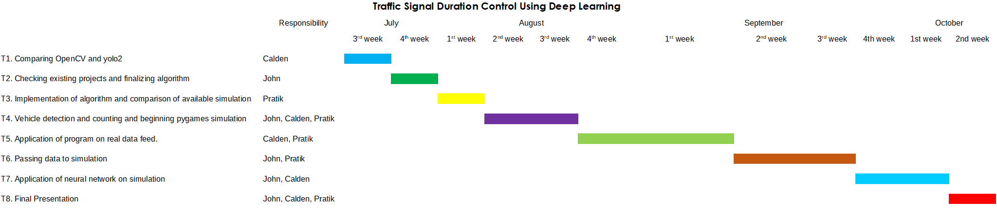
Project Plan

Slide 9
References
[1] S. Sheik Mohammed A Multiple Inductive loop vehicle Detection System. 2012 IEEE Transaction on Instrumentation and Measurement.
[2] R. Scheepjens. Algorithm Design for Traffic Signal Timings Predictions of Vehicle-Actuated Controlled Intersections. 2016 IEEE Conference on Computer Vision and Pattern Recognition (CVPR)
[3] Brutzer, S., Hoferlin, B., & Heidemann, G. (2011). Evaluation of background subtraction techniques for video surveillance. CVPR 2011.
[4] Ivan Culjak ; David Abram ; Tomislav Pribanic ; Hrvoje Dzapo ; Mario Cifrek A brief introduction to OpenCV 2012 Proceedings of the 35th International Convention MIPRO
[5] Foy, Mark D, Benekohal, Rahim (Ray) F, Goldberg, David E, 1992, “Signal Timing Determination Using Genetic Algorithms”

